Slide 1
Introduction
to
Eko Atlantic

Slide 2
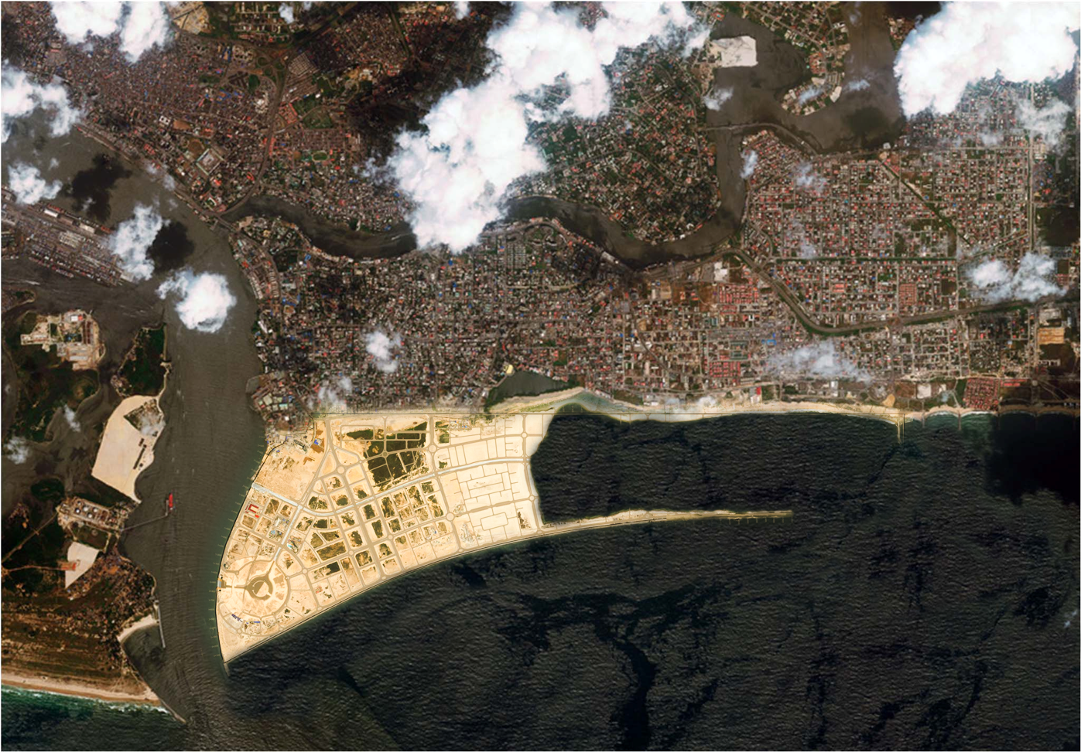
EKO
ATLANTIC’S
LOCATION
VICTORIA ISLAND
LEKKI
EKO ATLANTIC

Slide 3
KEY FACTS: EKO ATLANTIC
Size: 10 Million Square Meters.
Residents: 300,000, Commuters: 200,000.
Location: Adjacent To Victoria Island And Lekki.
100% Privately Funded.
Eko Atlantic: Financial, Commercial, Residential Free Zone

Slide 4
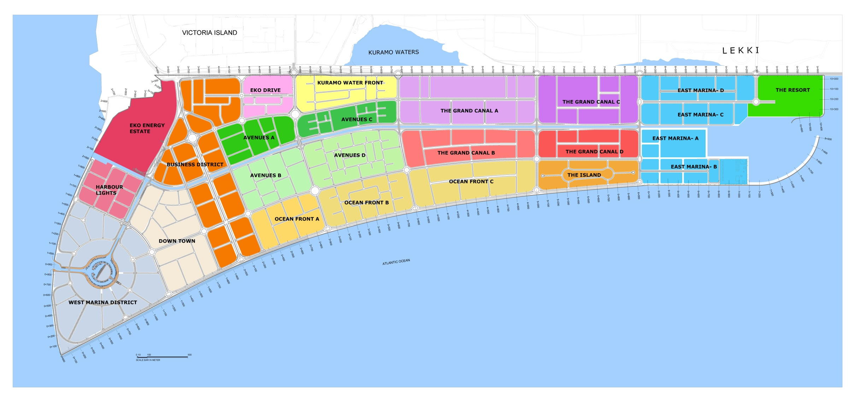
EKO ATLANTIC MASTER PLAN

Slide 5
EKO ATLANTIC - INFRASTRUCTURE
World-class Roads Network, Purpose Built And Privately Maintained
Autonomous City, Fiber Optic Network Connected and Managed By Eko Atlantic
Dedicated Power Station, Water & Sewerage Treatment Plant.
Regional Shopping Mall, International Hospital & School
Direct Access To Lagos Rail Network, West African Coastal Highway And Lagos Waterways

Slide 6
INFRASTRUCTURE
Electricity: 70MW Expandable To 1.5GW Power Plant.
Efficient Lighting: Led For Street Lighting.
Potable Water: 10,000m3 Per Day Expandable To 100,000m3.
Smart City Planning Working Inline With City Wide Fiber Optic Network.
State-of-the-art Sewage Facility.
Extensive Underground Storm Water Drainage

Slide 7
THE GREAT WALL OF LAGOS
Purpose Is To Protect The City From Ocean Surge.
Composed Of A Concrete Wave Deflector Wall And Upon Completion, It Will Include A Scenic 12m Pedestrian Promenade.
Height Is 9m Above Sea Level , Length Is 8,5km And The Width Is 46m.
Proven To Have The Ability To Withstand And Endure The Most Severe Tidal Surges Forecast Over The Next 1000 Years.

Slide 8
KEY POINTS: BUSINESS DISTRICT
650,000m² Of Land Available For Development / Co-development.
Eko Boulevard – 2 Kilometers Long, 60 Meters Wide.
With a F.A.R. Of 6 The Potential For Residential & Office Development Is Around 3.9 Million Sqm

Slide 9
KEY POINTS: THE MARINA DISTRICT
760,000 Sqm Of Land.
300m Wide , 70,000 Square Meter Marina.
Enough Space For Hundred Boats To Dock.
Surrounded By A Large Base Pedestrian Walkway Of More Than 1km Long Accommodating Restaurants, Retail And Open Spaces.
With an F.A.R. Of 6 The Potential For Residential, Commercial And Hotel Development Is Around 4.5 Million Sqm.

Slide 10
KEY POINTS: THE SHOPPING MALL
Largest Mall In Sub Saharan Africa.
High Quality Retail Layout For Great Shopping Experience.
Vast Amenities For Entertainment - (Food Courts, Cinema, Playground)
Ample And Efficient Parking Within The Premises

Slide 11
City Connectivity
New Railway Networks in Lagos.
Ferry Networks / Water Taxis.
New Highways Connecting the City.

Slide 12
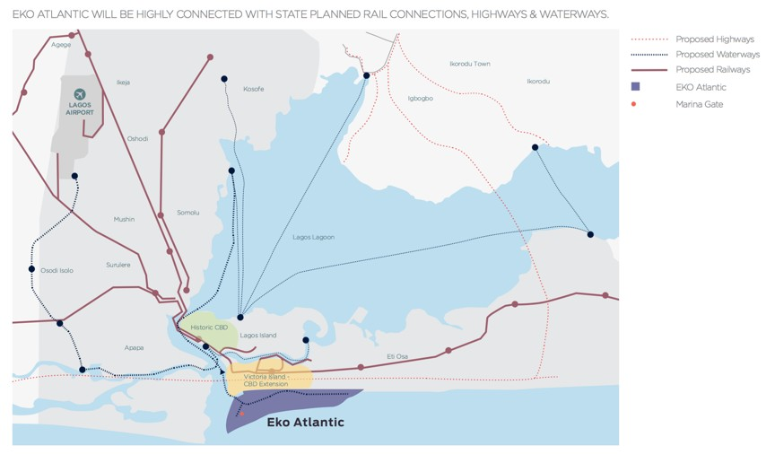
ACCESSIBILITY & LOCATION

Slide 13
Why To Locate In Eko Atlantic?
The Economic Free Zone And The Significant Cost Savings This Will Offer Investors And Occupiers.
Land Economy: Develop The Same Size Building On A Smaller Site Due To The Higher Floor Area Ratios (FAR) On Offer At Eko Atlantic (1 to 2 Parking Floors Below Street Level and Above Water Table).
Develop The Same Size Building On A Smaller Site Due To The Higher Floor Area Ratios (Far) On Offer At Eko Atlantic

Slide 14
Why To Locate In Eko Atlantic?
Lower Construction Costs.
High Quality Soil Resulting In Reduced Piling Costs.
Excavation Costs Reduced, Site Preparation Is Already Completed.
Dewatering Costs Are Eliminated Or Significantly Minimized.
No Need For Additional Infrastructure, Boreholes, Generators, Water Treatment And Sewage Disposal.

Slide 15
ECONOMIC FREE ZONE HIGHLIGHTS
Complete Holiday From All Federal, State And Local Government Taxes, Rates, And Levies.
Duty Free Importation Of Capital Goods, Machinery/Components, Spare Parts, Raw Materials And Consumable Items In The Zones.
100% Foreign Ownership Of Investments.
100% Repatriation Of Capital, Profits And Dividends.
Waiver Of All Imports And Export Licenses.
One-stop Approvals for Permits, Operating License & Incorporation Papers
Waiver On All Expatriate Quotas For Companies Operating In The Zones

